Slide 1

SIGN LANGUAGE RECOGNITION USING GRAPH AND DEEP NEURAL NETWORK BASED ON LARGE SCALE DATASET
BHAGYA A JAI
B21CSB18
5 AUGUST 2024

Slide 2
OVERVIEW
INTRODUCTION
PROBLEM REVIEW
DATASETS
OBJECTIVES
METHODOLOGY
RESULTS
CONCLUSION
REFERENCES

Slide 3
INTRODUCTION
SIGN LANGUAGE : A KEY COMMUNICATION TOOL
Essential for the hearing-impaired
Uses facial, body, and hand gestures.
CHALLENGES FACED
COMPLEXITY IN LEARNING
LACK OF INTEREST
VARIATIONS ACROSS REGIONS

Slide 5
CURRENT METHODS AND ISSUES
SENSOR BASED SYSTEMS
Costly and less portable
VISION BASED SYSTEMS
Background complexity and
Occlusion
PIXEL BASED SYSTEMS
Background issues
SKELETAL BASED SYSTEMS
Lacks efficiency and generalisation

Slide 6
PROPOSED GCAR SYSTEM
Innovative Approach: Captures spatial-temporal information.
Two stream model: Processes joint key features , processes joint motion , combines for classification.
Performance: High accuracy on benchmark datasets.
Impact: Sets new standard in SLR and improve generalization and real-time use

Slide 7
PROBLEM REVIEW
The following issues are being addressed :
COMMUNICATION GAP
LEARNING COMPLEXITY
CURRENT LIMITATIONS
INCOMPLETE GESTURE RECOGNITION
DATASET LIMITATIONS

Slide 8
DATASETS
WLASL Dataset
Largest ASL dataset: 68,129 videos, 20,863 glosses.
Composition: 34,404 videos, 3,126 glosses.
Subsets: WLASL100, WLASL300, WLASL1000, WLASL2000.
MSL Dataset
Features: Two hands, body, face in 67 key points.
Composition: 30 signs, 25 repetitions per sign, 3,000 samples.
Frames: 20 frames per video.

Slide 9
ASLLVD Dataset
Description: American Sign Language Video Dataset.
Composition: 2,745 sign words, 7,798 training/testing videos.
Features: Multiple angles, morphological/articulatory labels.
Pakistani Sign Language Dataset
Features: Whole body, face, hand skeletons (67 key points).
Composition: 12 word signs, 37 alphabet signs, 9 participants.
Technology: MediaPipe, OpenPose systems.

Slide 10
OBJECTIVES
Develop a two-stream model utilizing multistage graph convolution with attention and residual connection (GCAR) to extract spatial-temporal contextual information for sign language recognition.
SIMPLIFY LEARNING
ENHANCE COMMUNICATION
LEVERAGE LARGE SCALE DATASETS
OVERCOME SYSTEM LIMITATIONS
COMPREHENSIVE RECOGNITION

Slide 11
METHODOLOGY
MODEL ARCHITECTURE
Input Pose Sequence
Sequence of input pose: X(1:N)=[x1,x2,x3,...,xN]
Xi ​∈RK, concatenated skeleton key points in dimension KXK.
Two Stream Model
Stream 1: Processes joint key points.
Stream 2: Processes joint motion
Creation of the final feature for classification

Slide 12
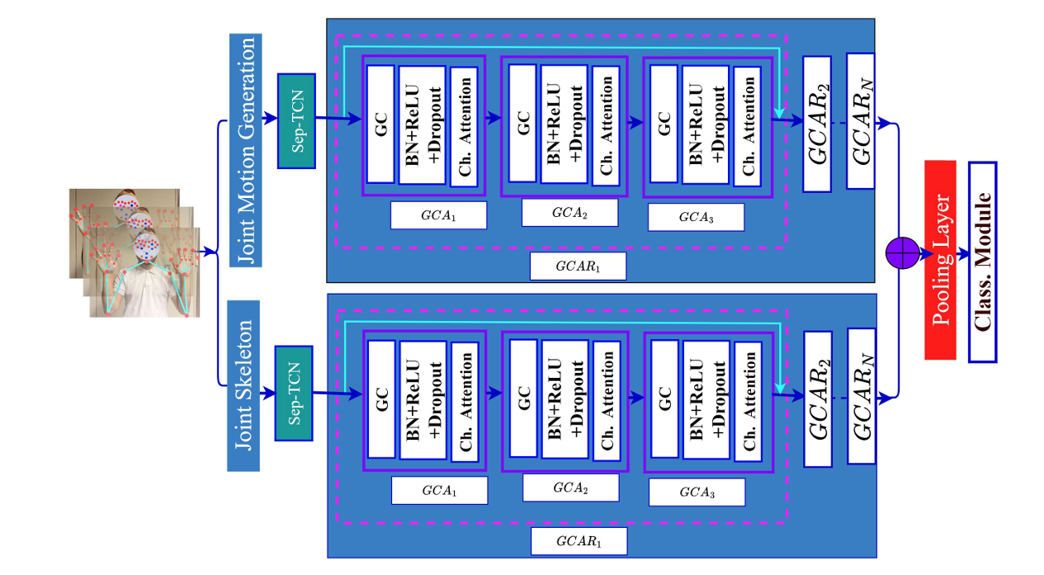

Slide 13
COMPONENTS OF THE TWO-STREAM MODEL
POSE ESTIMATION
MOTION CALCULATION
SEPARABLE TCN
GRAPH CONVOLUTION WITH ATTENTION (GCA) MODULE
GRAPH CONSTRUCTION
GRAPH CONVOLUTION
CHANNEL ATTENTION
MULTI-STAGE OF GRAPH CONVOLUTION WITH ATTENTION AND RESIDUAL CONNECTION (GCAR) APPROACH
CLASSIFICATION MODULE

Slide 14
A.POSE ESTIMATION
Purpose: Recognizes gestures and activities.
Key Info: Uses skeleton joints, not skin details and identifies via hand movements.
Biometric Security: Protects against unauthorized access.
Sensitive Data: Excludes palm prints and fingerprints.
Comprehensive Approach: Combines face, body, and hand data.
Privacy Focus: Conceals personal details.
Dataset: 67 key points: 42 hands, 5 body, 20 face.

Slide 15
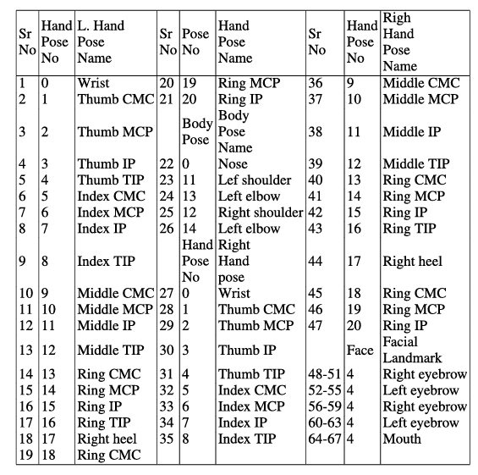
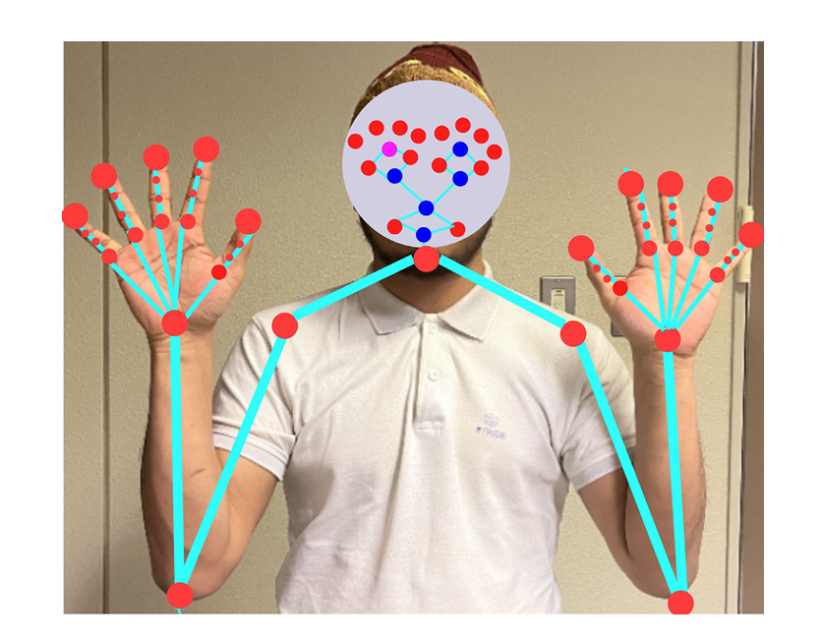
POSE AND GRAPH CONSTRUCTION
DESCRIPTION OF THE 67 WHOLE BODY KEY POINTS

Slide 16
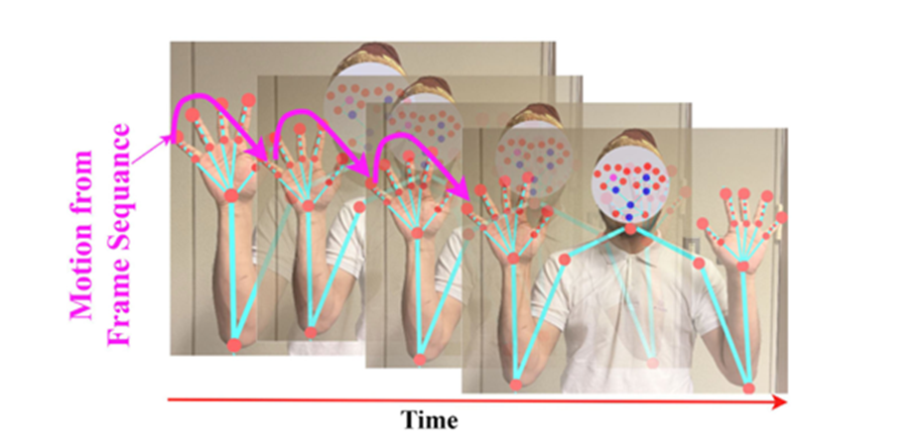
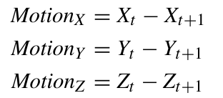
B.MOTION CALCULATION
Purpose: Enhance feature extraction for dynamic sign language recognition.
Method: Extract motion from framing sequences before GC model input.
Key Feature: Movement of joint skeleton.
Process:
Calculate 2D vectors using x, y, and z coordinates of 67 skeleton key points.
Compute joint position differences between consecutive frames.
Equations: ​

Slide 17
C.SEPARABLE TCN
Overview: A variant of Temporal Convolutional Networks (TCN), also known as Depth wise Separable TCN.
Goal: Optimize the balance between computational efficiency and model performance by minimizing parameters.
Conventional CNN Issue: High computation costs (FLOPS) due to numerous multiplication operations.

Slide 18
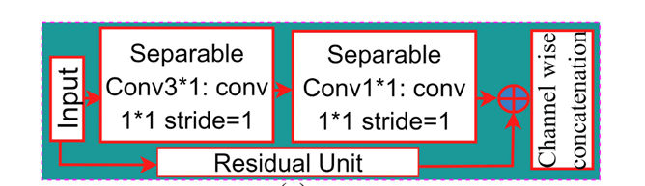
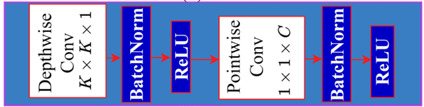
Separable TCN Approach:
Depth-Wise (DW) Convolution: K×K×1operations.
Point-Wise (PW) Convolution: 1×1×C operations.
Result: Reduced operations per kernel and decreased total parameters without compromising performance.
1st Sep-TCN Layer: 3×1 filter, stride 1.
2nd Sep-TCN Layer: 5×1 filter, stride 2.
SepTCN
INTERNAL STRUCTURE OF THE SEPARABLE TC

Slide 19
D.GRAPH CONVOLUTION WITH ATTENTION (GCA) MODULE
Purpose: Extract local and global spatial-temporal features.
Components:
Graph Convolution Layer: Enhances long-range dependencies.
Deep Learning Layers: Batch normalization, ReLU, and dropout for short-range dependencies.
Channel Attention Layer: Enhances channel-wise effective features.

Slide 20
1.GRAPH CONSTRUCTION
Dynamic Datasets: Sequences of frames with 2D joint skeleton vectors.
Graph Formation:
Nodes: Joint motions.
Edges: Natural joint connections.
Objective: Generate higher-level feature maps via spatial-temporal graph convolution with attention (GCA).

Slide 21



Graph Structure:
Fully connected with N= 67 nodes.
Equation:
,V (vertices) and E (edges).
Vertices defined by joint coordinates across frames:
Weighted adjacency matrix representing edges between nodes:

Slide 22
2.GRAPH CONVOLUTION
Purpose: Process graph-structured data, such as joint skeletons, to extract features and patterns.
Concept: Aggregate information from neighboring nodes to update the central node's features through multiple layers.
Input: Sequence of frames (Vt​) with N joint skeleton nodes at time t.

Slide 23
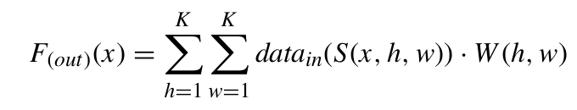
General Convolutional Neural Network (CNN) Equation:
x: Spatial location for a single channel
S: Sampling function
W: Weight function.

Slide 24
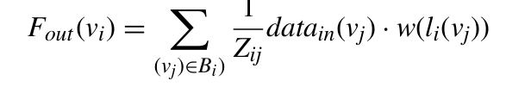
Graph Convolution Equation:
Z: Normalization term to balance node contributions
Bi​: Subset of nodes for mapping
w(⋅): Weight matrix.

Slide 25

Updated GC Equation:
A: Adjacency matrix
data: Input data
W: Weight matrix
σ: Activation function.

Slide 26
3.CHANNEL ATTENTION
Purpose: Enhance important channel-wise features.
Process:
GCAR processes motion features through deep learning layers.
Produces a feature matrix with multiple channels.
Mechanism:
Generates a weighted feature map using global average pooling.
Fully connected layers normalize and activate the features.
Creates a weight vector to emphasize important features.

Slide 27
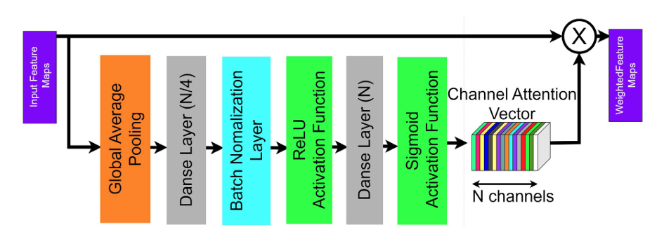

Slide 28
Output:
Adjusted GCAR features
Enhanced important ones
Suppressed less important ones.

Slide 29
E.MULTI-STAGE OF GRAPH CONVOLUTION WITH ATTENTION AND RESIDUAL CONNECTION (GCAR) APPROACH
Components:
Graph Convolutions with Channel Attention (GCA) modules
Includes graph convolutional layers, ReLU, batch normalization, dropout, and channel attention
Process:
Inputs motion feature output
Convolves N×T×C feature map
Concatenates third GCA output with residual connection

Slide 30
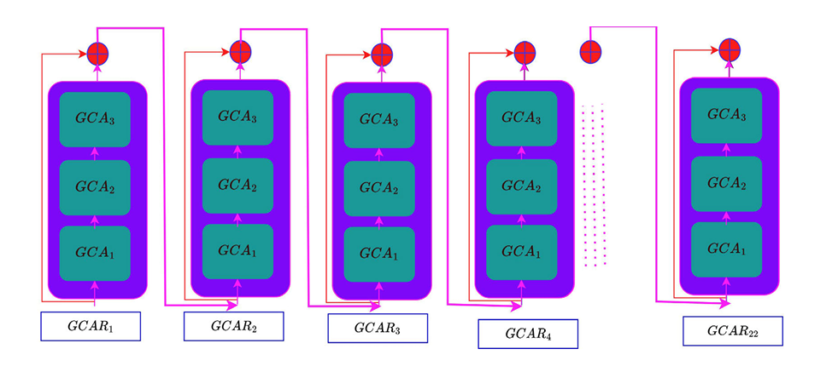
Implementation:
22 sequential GCAR modules used

Slide 31
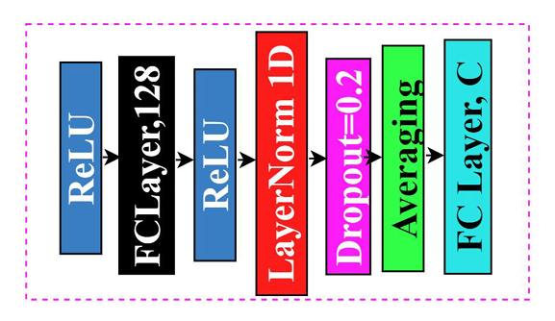
F.CLASSIFICATION MODULE
Converts the matrix into a feature vector
Components:
ReLU activation
Fully connected layer
Batch normalization
Dropout layer
Averaging

Slide 32
RESULTS
A. Experimental Setting
Dataset Splitting: Training (70%) and testing (30%)
Hardware: GeForce RTX 3090 (24GB), 32GB RAM
Training: Learning rate 0.003, batch size 32, 300 epochs
Software: Python with PyTorch, OpenCV
B. Evaluation Metric
Metric: Mean top-K classification accuracy (K=1, 5, 10)
Correction: Contextual information corrects misclassifications.

Slide 33
C. Ablation Study
Configurations:
Without Attention (55 and 67 joints)
With Attention (67 joints)
D. Performance Comparison
DATASET | DESCRIPTION | ACCURACY
WLASL | Large-scale American Sign Language | 90.31%
PSL | Comprehensive sign language | 94.10%
MSL | Dynamic Mexican Sign Language | 99.75%
ASLLVD | Large-scale American Sign Language | 34.41%

Slide 34
CONCLUSION
GCAR Model: Two-stream multistage architecture for spatial-temporal feature extraction.
First Stream: Utilizes joint skeleton points, sep-TCN, GCN, and channel attention.
Second Stream: Processes joint motion information and fuses with the first stream.
Performance: High accuracy on large-scale sign language datasets.
Future Scope: Enhancing accuracy with multi-camera recognition for practical applications.

Slide 35
REFERENCES
A. S. M. Miah, J. Shin, M. A. M. Hasan, and M. A. Rahim, “BenSignNet: Bengali sign language alphabet recognition using concatenated segmentation and convolutional neural network,” Applied Sciences, vol. 12, no. 8, p. 3933, Apr. 2022.
A. S. M. Miah, J. Shin, M. Al M. Hasan, M. A. Rahim, and Y. Okuyama, “Rotation, translation, and scale invariant sign word recognition using deep learning,” Computer Systems Science and Engineering, vol. 44, no. 3, pp. 2521–2536, 2023.
J. Shin, A. S. Musa Miah, M. A. M. Hasan, K. Hirooka, K. Suzuki, H.-S. Lee, and S.-W. Jang, “Korean sign language recognition using transformer-based deep neural network,” Applied Sciences, vol. 13, no. 5, p. 3029, Feb. 2023.
A. S. M. Miah, M. A. M. Hasan, J. Shin, Y. Okuyama, and Y. Tomioka, “Multistage spatial attention-based neural network for hand gesture recognition,” Computers, vol. 12, no. 1, p. 13, Jan. 2023.

Slide 36
THANK YOU

Slide 37
LITERATURE REVIEW
Sign Language Structure
Stokoe Paradigm: Defines SL components based on shape, alignment, and motion.
Hand Shapes: Static and dynamic frames capture meanings.
Systems and Techniques
Vision-based Systems: Preferred for ease, portability, and low cost.
Feature Extraction: HOG: 78.85% accuracy (Raghuveera et al.). JFMs: 95% accuracy (Solis et al.).

Slide 38
Deep Learning Approaches
CNN on ASL: Good performance (Miah et al.).
ModDrop Framework: Uses RGB image and audio
(Neverova et al.).
Multi-stage Technique: CTC and 3D-ResNet with LSTM
(Put et al.).
Advanced Models
CNN-HMM Hybrid: High accuracy(Koller et al.).
3D-CNN with Attention: 95.3% accuracy (Huang et al.).
LSTM, CNN, and Pooling: 93.15% accuracy (Sincan et al.).

Slide 39
Skeleton-based Methods
Skeleton Points: Avoid occlusion and background issues.
Tools: Alphapose, OpenPose, MediaPipe.
GCN and Attention Networks: Hand skeleton analysis (Musa et al.).
Whole-body Information
67 Skeleton Points: Enhances inter-gesture variance (Amorim et al.).
Body, Face, and Hands for MSL: Good accuracy
(Solis et al.).
Whole-body Key Points Dataset: High performance
(Peraz et al.).

Slide 40
Large-scale Datasets
ASL World Dataset: 2000 classes, 62.63% top-10 accuracy with TGCN (Li et al.).
Proposed Method
GCAR Model : Enhances accuracy and Effectiveness in SLR systems

Slide 41
LITERATURE REVIEW
A. S. M.Miah, J. Shin, M. A. M. Hasan, and M. A. Rahim | BenSignNet: Bengali sign language alphabet recognition using concatenated segmenta tion and convolutional neural network
A. S. M. Miah, M. A. M. Hasan, J. Shin, Y. Okuyama, and Y. Tomioka | Multistage spatial attention-based neural network for hand gesture recognition
M. A. Rahim, A. S. M. Miah, A. Sayeed, and J. Shin | Hand gesture recognition based on optimal segmentation in human-computer interaction

